Slide 1

Mizuho dashboard
PQM InnoTeam

Slide 2
Objective
To bring Dashboard culture to Mizuho
Using tools such as Tableau, Qlik Sense, Microsoft BI (business intelligence) which are popular analytical dashboard tools
Business users and non-IT savvy staff can easily create the dashboards

Slide 3
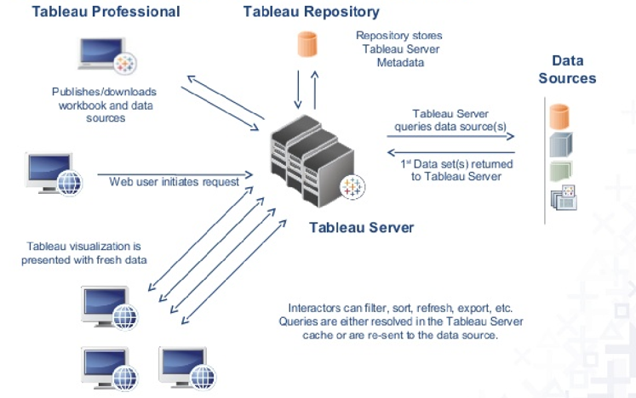
Goal
Deploy Tableau Server to enable collaboration and empower more users to gain insights from the dashboard while ensuring data governance
Centralized environment
Using Active Directory to access i.e. login using own Windows ID
Using web browser, no installation required

Slide 4
involved Parties
This is a collaboration between
PQM
AIOD
Tableau

Slide 5
Dashboard Tool - Tableau
What's Tableau
Grand master” of data visualization software
over 60,000 user accounts across a multitude of industries
interactive interface with simple drag-and-drop functionality speeds up and simplifies the creation process
can easily handle large, fast-changing datasets
integrates smoothly with various technologies e.g. Hadoop, AWS, MySQL, SAP and Teradata

Slide 6
Dashboard Tool - Tableau
Tableau is not new to Mizuho
Currently we have 22 desktop licences (9 desktop, 13 creator) managed by different departments and having different expiry dates
AOOP/AOAD 7 (Desktop-6 Creator-1)
AOTD 3 (Desktop-3)
RMD 3 (Creator-3)
MRD 4 (Creator-4)
AIOD 5 (Creator-5)

Slide 7
Infra & Deployment
Tableau and Licences
Hardware
- AIOD will prepare server by using existing hardware for production. Dev server to be confirmed.
Software
- Convert desktop to server licence
- Align to same expiry date(Same annual cost when we renew desktop licences)
- InnoTeam to decide on how many new licences to purchase
- Viewer licence

Slide 8
Next Steps
Training
Tableau
Tableau Virtual Bootcamp
Tableau online eLearning
PQM
Workshops
For users who need to create new workbooks, dashboards (Creators)
For users who need to view and interact with published workbooks, dashboards (Viewers)

